Slide 1
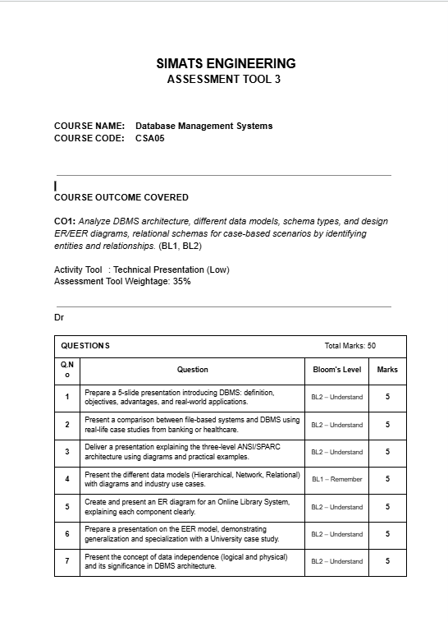
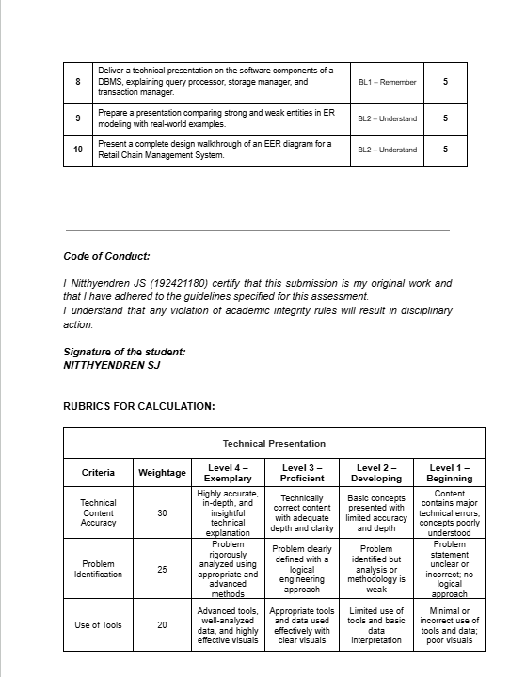

Slide 2


CSA-0501
Database Management System-Technical Presentation
DBMS
Nitthyendren JS
192421180

Slide 3
TOPIC 1 · UNDERSTAND
02 / 12
Introduction to DBMS
Definition: A Database Management System (DBMS) is software that creates, organises, stores and manages data, letting users and applications define, insert, query, update and delete data reliably, while enforcing integrity, security and controlled concurrent access.
?
O
Objectives
A
Advantages
Ensure data independence between applications and storage
Minimise data redundancy and duplication
Enforce integrity, accuracy and consistency constraints
Provide security through authentication and access control
Support concurrent multi-user access safely
Enable backup, recovery and crash resilience
Reduced redundancy and controlled data sharing
Consistent, accurate data across all users
Strong security and role-based access
Efficient querying via SQL and indexing
Real-World Applications
Banking
Healthcare
E-commerce
Airlines
Education

Slide 4
TOPIC 2 · UNDERSTAND
03 / 12
File-Based Systems vs DBMS
Aspect | File-Based System | DBMS
Data redundancy | High — same data repeated in many files | Minimised through centralised storage
Data integrity | No built-in constraints | Enforced via keys & constraints
Concurrent access | Difficult, prone to conflicts | Managed via locking & transactions
Security | Weak, file-level only | Role-based, fine-grained access
Recovery | Manual, unreliable | Automated backup & recovery
$
Banking Case Study
+
Healthcare Case Study
Legacy branch-wise file systems caused duplicate, inconsistent account balances. Core banking DBMS platforms now use ACID transactions so fund transfers stay accurate across all branches and ATMs in real time.
Paper and isolated file records led to duplicated, hard-to-share patient histories. Electronic Health Record (EHR) DBMS platforms unify lab, pharmacy and doctor data, improving diagnosis accuracy and reducing errors.

Slide 5
TOPIC 3 · UNDERSTAND
04 / 12
Three-Level ANSI/SPARC Architecture
EXTERNAL LEVEL
Why three levels?
Teller
View
Manager
View
Auditor
View
External: what each user/application sees — tailored views hide irrelevant detail.
Conceptual: the single shared logical design used by the whole organisation.
Internal: how data is actually stored and indexed on disk for performance.
Example: in a bank, a teller's view shows only balances; the manager's view adds branch performance data — both draw from one conceptual schema, stored internally as indexed files for fast lookup.
CONCEPTUAL LEVEL
Community logical schema — entities, relationships, constraints (independent of any single user view)
INTERNAL LEVEL
Physical storage — indexes, file organisation, access paths on disk
Two mapping layers (external↔conceptual, conceptual↔internal) give data independence

Slide 6
TOPIC 4 · REMEMBER
05 / 12
Data Models
Hierarchical
Network
Relational
CEO
Supplier
Warehouse
ID | Name | Dept
101 | Asha | IT
102 | Ravi | HR
Manager A
Manager B
Part
One parent → many children (tree structure, single path to each record)
Records linked in a graph — a child can have multiple parents (many-to-many)
Data stored as rows & columns in related tables, linked by keys
Industry use: IBM IMS — early airline & banking systems; today's XML / file-directory trees.
Industry use: IDMS / CODASYL — legacy flight-reservation and inventory systems needing many-to-many links.
Industry use: Oracle, MySQL, PostgreSQL — the standard for banking, retail, ERP and almost all modern apps.

Slide 7
TOPIC 5 · UNDERSTAND
06 / 12
ER Diagram — Online Library System
AUTHOR
LIBRARIAN
WRITES
MANAGES
LOAN / ISSUE
BORROWS
BOOK
MEMBER
ISBN (PK)
Title
MemberID
Name
Genre
Rectangles = entities (Author, Book, Librarian, Member, Loan) Diamonds = relationships (Writes, Manages, Borrows) Ovals = attributes (ISBN, Title, MemberID...). A Member Borrows a Book, creating a Loan record; a Librarian Manages the catalogue; an Author Writes one or more Books.

Slide 8
TOPIC 6 · UNDERSTAND
Enhanced Entity-Relationship (EER) Model — University Case Study
PERSON (Superclass)
PersonID
Name
DOB
ISA
STUDENT
FACULTY
STAFF
RollNo, Major, GPA
EmployeeID, Dept, Rank
EmployeeID, Role
Disjoint, total specialization — every Person is exactly one of Student, Faculty or Staff
Specialization breaks PERSON into meaningful subclasses with extra attributes (top-down). Generalization is the reverse — combining Student/Faculty/Staff upward into a shared PERSON superclass (bottom-up), avoiding attribute duplication across university records.

Slide 9
TOPIC 7 · UNDERSTAND
08 / 12
Data Independence
Logical Data Independence
Physical Data Independence
Ability to change the conceptual (logical) schema — e.g. add a new table or attribute — without altering external views or application code.
Protects applications from changes in overall database design.
Harder to achieve than physical independence, since external views are derived directly from the conceptual schema.
Ability to change the internal (storage) schema — e.g. reorganise files, add indexes, switch storage devices — without affecting the conceptual schema.
Applications and users remain completely unaffected by storage-level tuning.
Relatively easier to achieve since it only requires updating the conceptual/internal mapping.
Significance in DBMS Architecture
Data independence is what makes the ANSI/SPARC three-level architecture work: the two mapping layers absorb changes at one level so they never ripple upward. This lets databases evolve — new indexes, restructured schemas, upgraded hardware — with minimal disruption, reduced maintenance cost, and no need to rewrite existing applications.

Slide 10
TOPIC 8 · REMEMBER
09 / 12
Software Components of a DBMS
1
2
3
Query Processor
▶
Storage Manager
▶
Transaction Manager
Parses, optimises and translates user SQL queries into low-level instructions the storage engine can execute efficiently.
Handles physical placement of data, indexes and buffers; interfaces directly with the operating system's file system.
Ensures ACID properties — coordinates concurrency control, logging, and recovery so transactions stay reliable.
How they work together
A user submits SQL → the Query Processor parses and builds an optimal execution plan.
The Storage Manager retrieves or writes the required blocks from disk/buffer pool using that plan.
The Transaction Manager wraps the whole operation, guaranteeing atomicity, consistency, isolation and durability (ACID), even under concurrent access or failure.

Slide 11
TOPIC 9 · UNDERSTAND
10 / 12
Strong vs Weak Entities in ER Modeling
Strong Entity
Weak Entity
CUSTOMER
EMPLOYEE
HAS
DEPENDENT
CustID (PK)
Name
Name (disc.)
Has its own primary key and can exist independently. Example: Customer, Employee, Book.
Has no full primary key of its own — identified only through its owner entity plus a discriminator. Example: Dependent (of Employee), Order Item (of Order). Shown with double-lined rectangle.
Key Differences
Primary key: strong entities self-identify; weak entities need the owner's key + a discriminator (partial key).
Existence: strong entities exist independently; weak entities cannot exist without their owning (identifying) entity.
Notation: strong entity = single-lined rectangle; weak entity = double-lined rectangle, linked via an identifying (double-lined diamond) relationship.

Slide 12
TOPIC 10 · UNDERSTAND
11 / 12
EER Diagram — Retail Chain Management
EMPLOYEE (Superclass)
SUPPLIER
SUPPLIES
ISA
MANAGER
CASHIER
SALE
MAKES
CUSTOMER
STORE
RECORDS
STOCKS
PRODUCT
Design Walkthrough
SUPPLIER supplies PRODUCT; each STORE stocks a range of PRODUCTs, tracked through the STOCKS relationship.
A SALE RECORDS transaction links a STORE to the PRODUCTs sold, and a CUSTOMER MAKES the purchase.
EMPLOYEE is specialised (EER ‘ISA’) into MANAGER and CASHIER — both inherit core attributes (ID, Name) while adding role-specific ones (e.g. Manager: TargetRevenue; Cashier: ShiftTiming).
This EER design captures the retail chain's full structure — supply, inventory, sales and staff roles — in one coherent, extensible schema.

Slide 13
Thank You
DB
Questions & Discussion
Database Management Systems — from foundations and architecture through ER/EER modelling and industry case studies.
Nitthyendren • B.E. Information Technology • SIMATS

